Slide 1
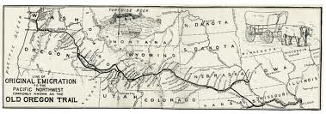
The Oregon Trail
Pay attention now so you can play the game later.

Slide 2
Oregon Trail Activities
One paper per person
Make sure your name is on it
Make sure to hand it in at the end of the period
You may collaborate with the people around you

Slide 3
Warm Up Question
If you had to survive out in the wilderness by yourself and could only take 1 item what would it be?
Explain your choice in two complete sentences.

Slide 4
My Choice

Slide 5
Item Inventory Activity
Directions: Make a list of 10 items (tools and equipment only) that you will need to take with you along the Oregon Trail. Then after each item write a sentence on why this item is necessary for your journey.
Time Period – Mid 1800’s
Example:
Rifle – This item is needed for hunting and self defense if necessary.

Slide 6
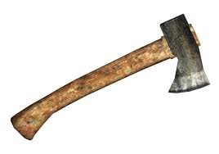
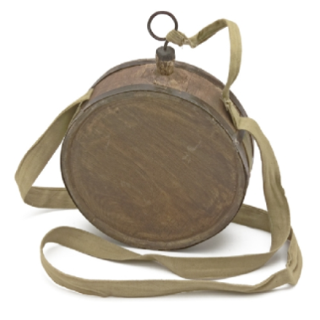
Possible Items

Slide 7
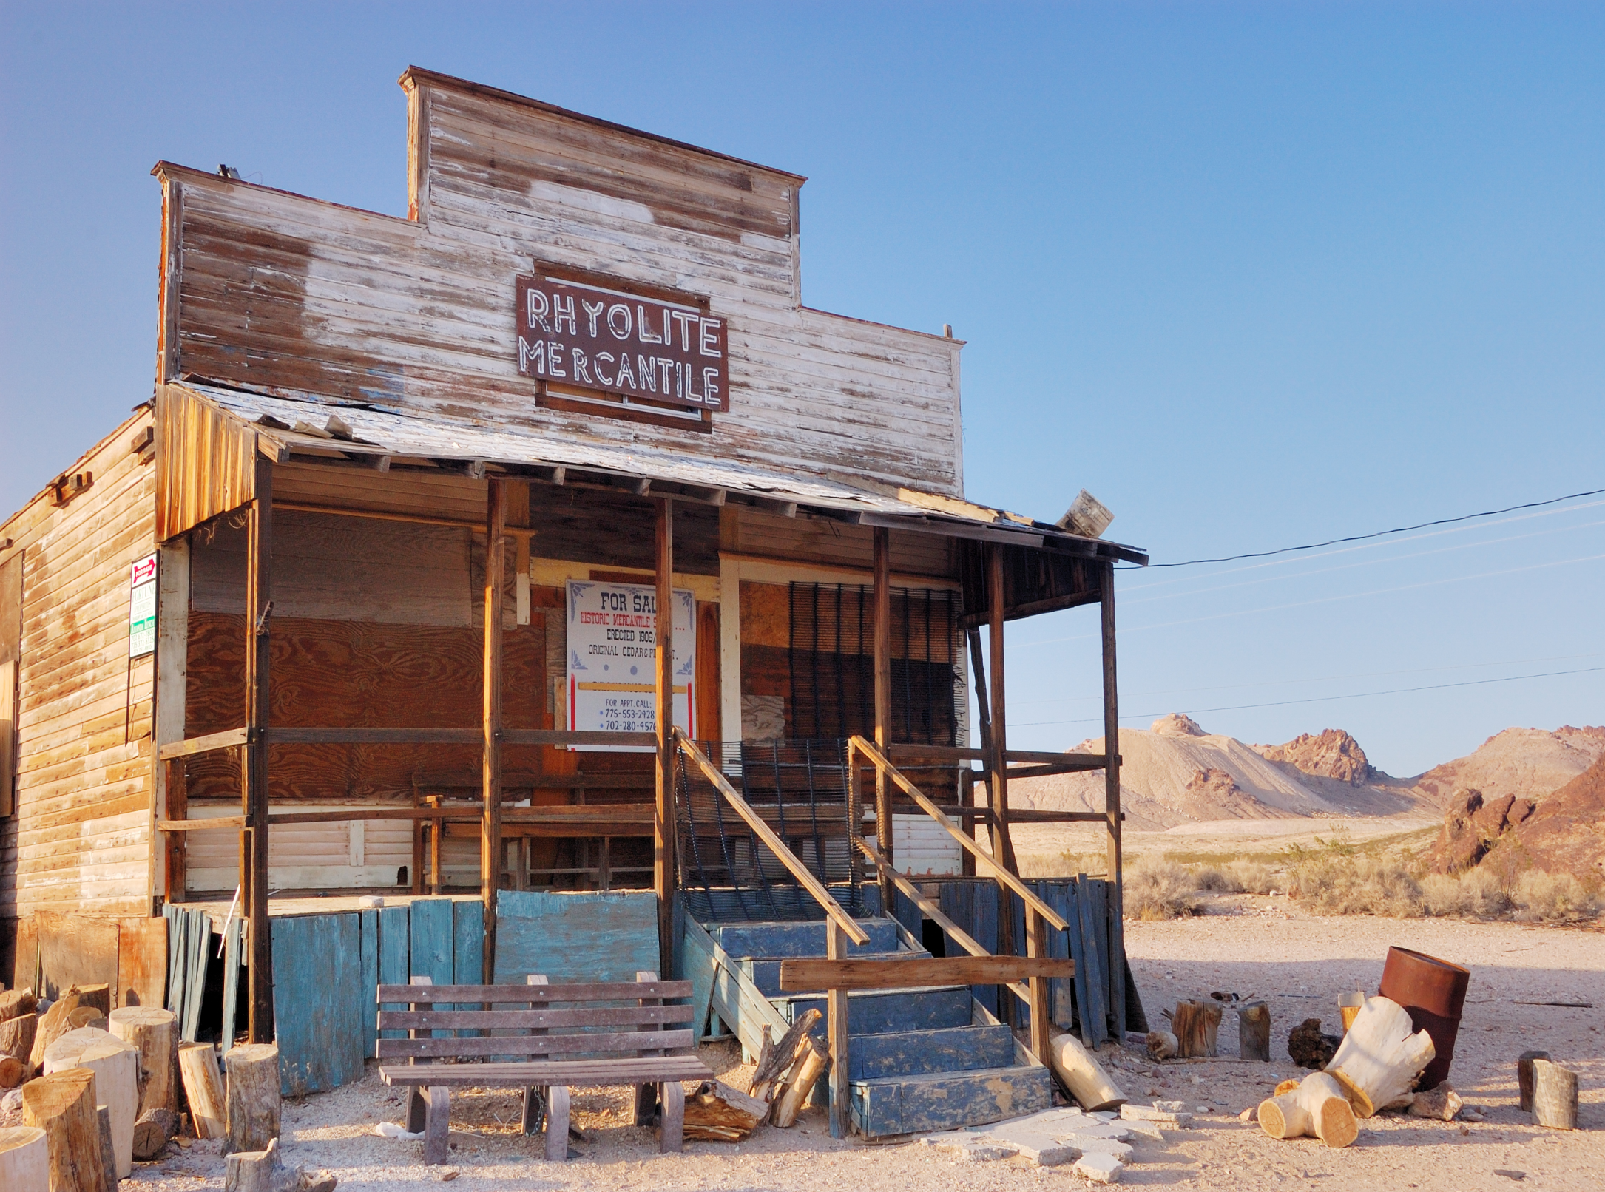

Slide 8
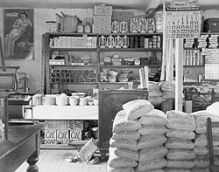

Slide 9
Took around 157 days

Slide 10
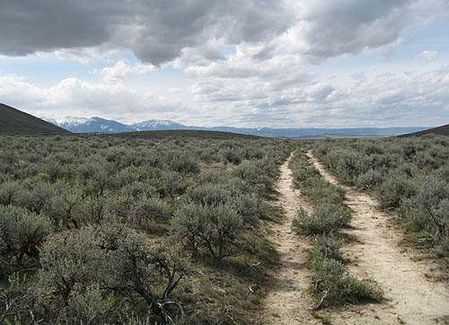

Slide 11
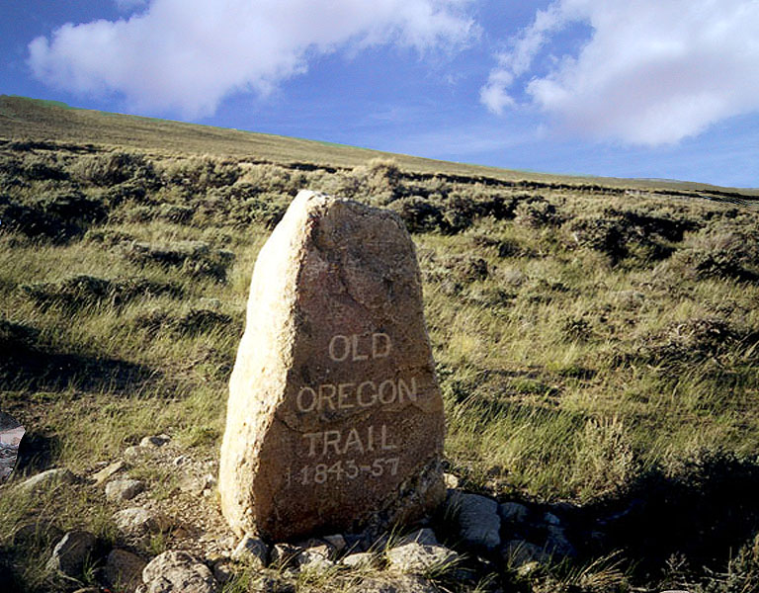

Slide 13
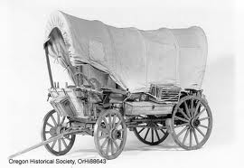

Slide 14
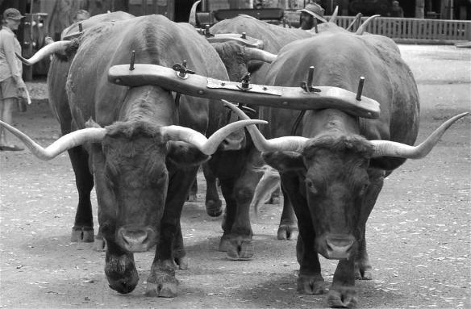

Slide 15
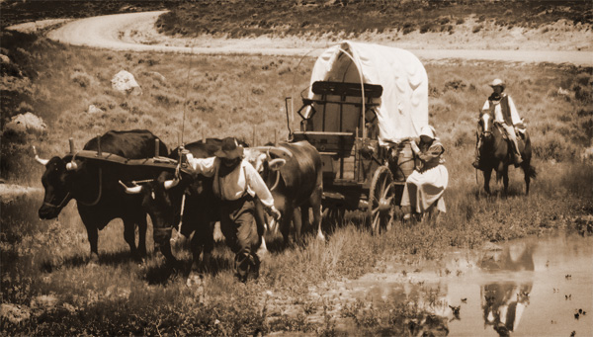

Slide 16
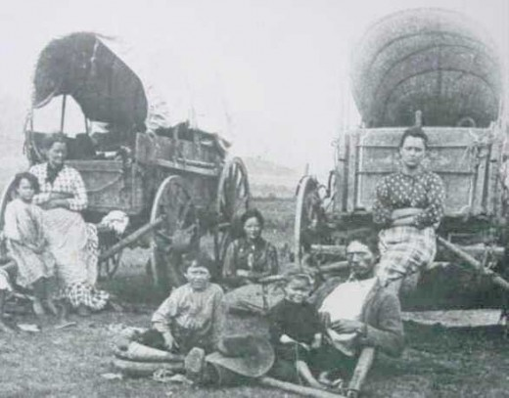

Slide 18
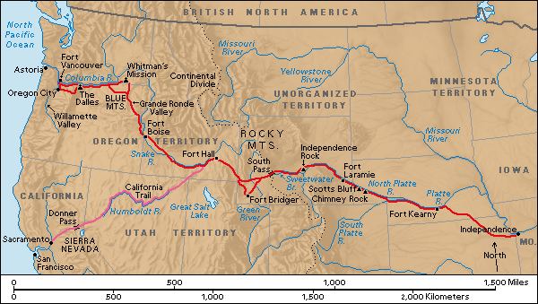
Around 2000 Miles Long

Slide 19
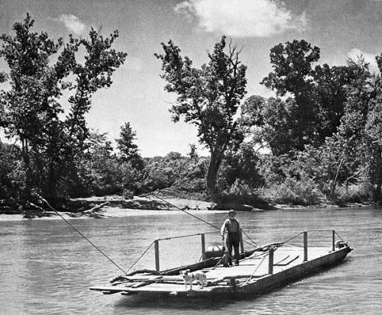

Slide 20
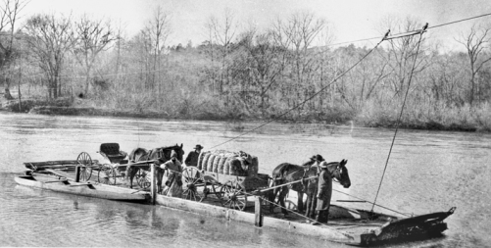

Slide 21
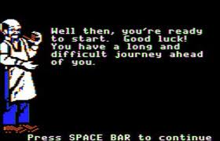

Slide 23
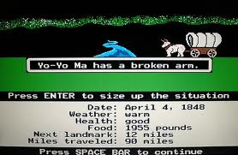

Slide 24
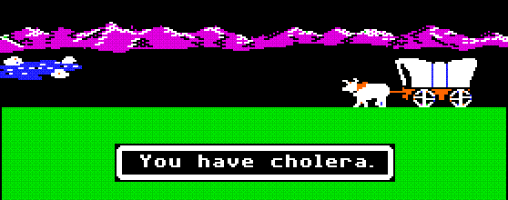
Cholera- is an infection of the small intestine caused by the bacterium Vibrio cholerae. The main symptoms are profuse, watery diarrhea and vomiting. Transmission occurs primarily by drinking water or eating food that has been contaminated by the feces of an infected person

Slide 25
Dysentery - an inflammatory disorder of the intestine, especially of the colon, that results in severe diarrhea containing mucus and/or blood in the feces with fever, and abdominal pain.

Slide 26
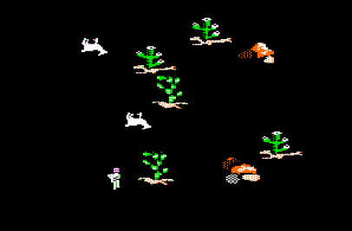
Food and supplies could be bought before the trip or procured through hunting or trade.

Slide 27
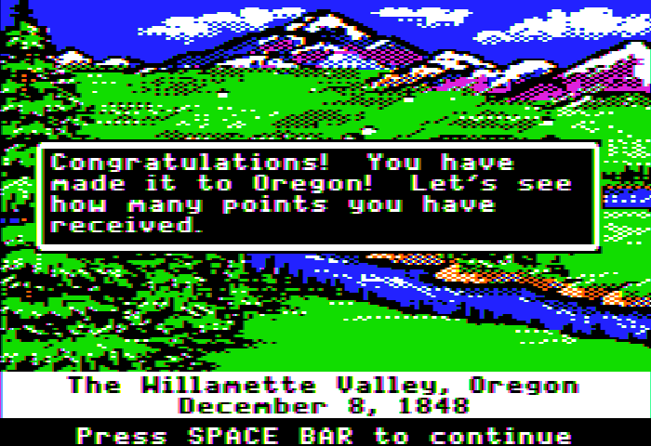

Slide 28
The travelers themselves would have walked (unless very ill) to leave more room in the wagon for supplies and put less stress on the oxen.

Slide 29
Journal Activity
Directions:
Write a 5 sentence journal entry as if you were a settler traveling along the Oregon Trail. Be sure to include some of the hardships you face, things you brought with, and your expectations of the Oregon Country.

Slide 30
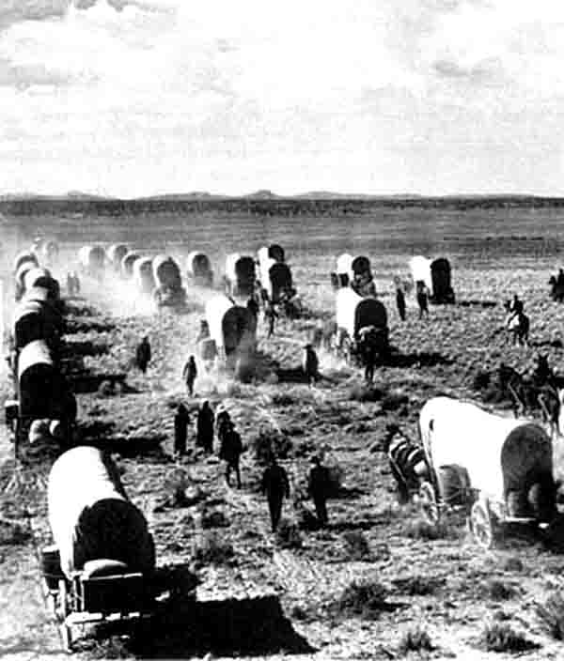
Closing Question
Identify three challenges settlers faced as they traveled on the Oregon Trail.

Slide 31
The Original Oregon Trail Game
USE GOOGLE CHROME!!
http://www.virtualapple.org/oregontraildisk.html
Open Chrome Webstore
Add to Chrome
Add
Go back to game page on other screen, press F5
Play game!

